Slide 1


01
Malicious Software
Pawan Subedi, 4

Slide 2
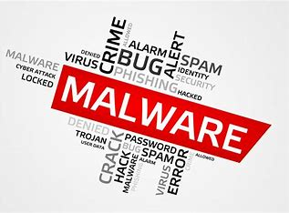

Introduction
Malicious software, often referred to as malware, is any software intentionally designed to cause damage to a computer, server, client, or computer network. By infiltrating systems without consent, malware can perform harmful actions such as stealing sensitive data, displaying unwanted ads, or disrupting system operations

Slide 3

Infection Points
Malware can infiltrate networks through various means, including:

Slide 4
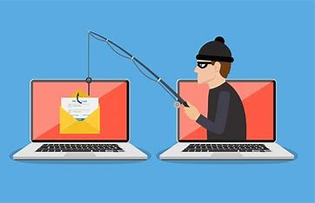
1
Downloading infected attachments or clicking malicious links in emails (phishing)

Slide 5
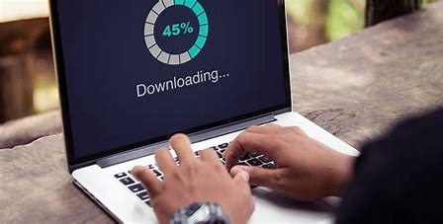
2
Downloading software from untrusted sources

Slide 6
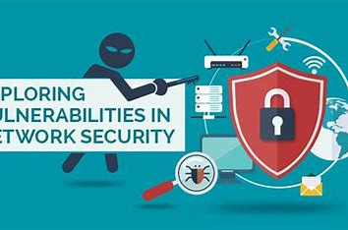
3
Exploiting vulnerabilities in software or operating systems

Slide 7
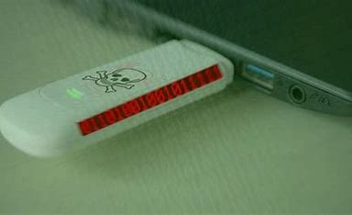
4
Infecting removable media (USB drives)

Slide 8
Impact on Networks
Steal sensitive data like login credentials, financial information, or intellectual property
Disrupt network operations by corrupting files or overloading systems
Install additional malware, creating a domino effect of infections
Launch Denial-of-Service (DoS) attacks to overwhelm and crash networks
Serve as a backdoor for hackers to gain remote access to the network

Slide 9
Types of Malware
Viruses: Self-replicating programs that spread by attaching themselves to other files
Worms: Network-propagating malware that exploits vulnerabilities to infect other devices
Trojans: Disguised programs that appear legitimate but perform malicious actions upon execution
Spyware: Malware that stealthily monitors user activity and steals data
Ransomware: Malware that encrypts a victim's files and demands a ransom for decryption

Slide 10
Defending Against Malware
Implementing endpoint security solutions with anti-malware capabilities on individual devices
Utilizing firewalls to filter incoming and outgoing traffic
Maintaining updated software and operating systems with the latest security patches
Educating users about cyber security best practices, like email security awareness and avoiding suspicious links
Regularly backing up data to ensure recovery in case of a malware attack

Slide 11


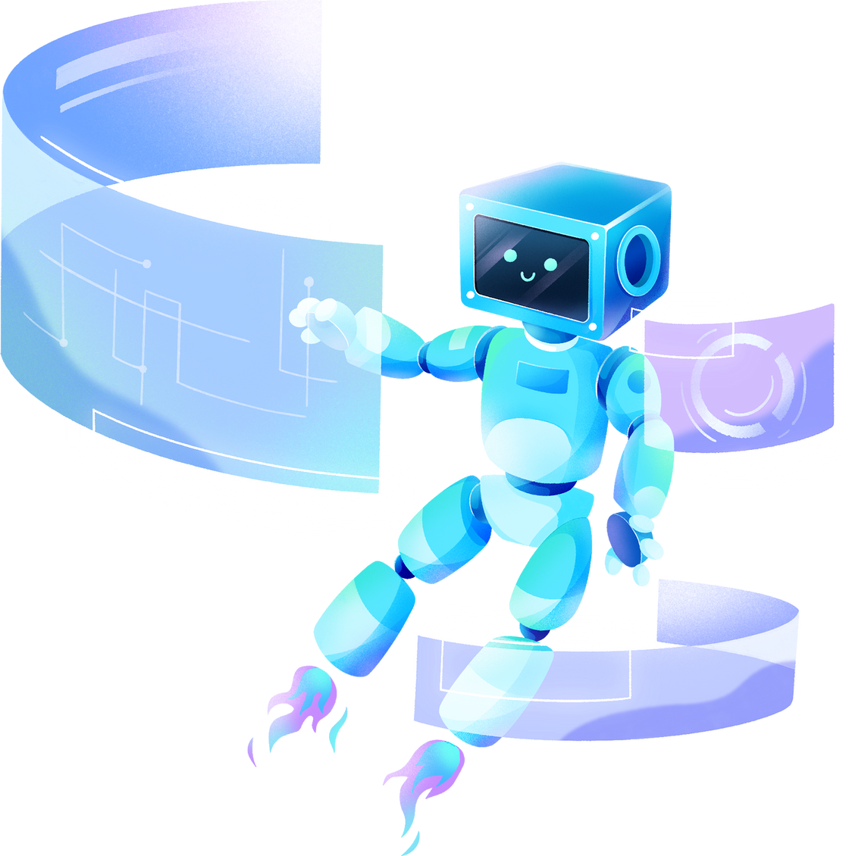
THANK YOU!

